Slide 1
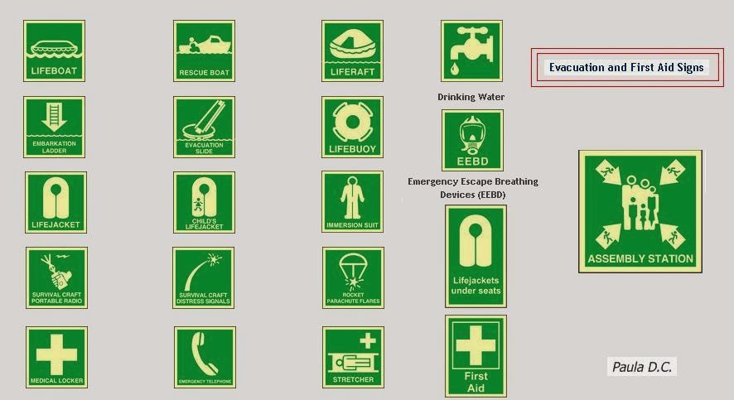

Slide 2
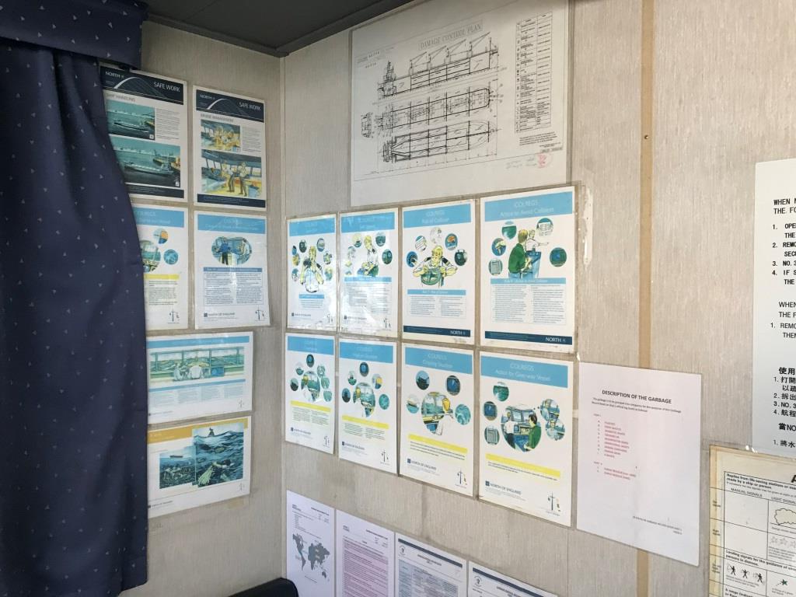
Problem Statement - View
Bulkhead clutter
Information Fatigue
Asymmetrical display
Tape stains on bulkhead

Slide 3
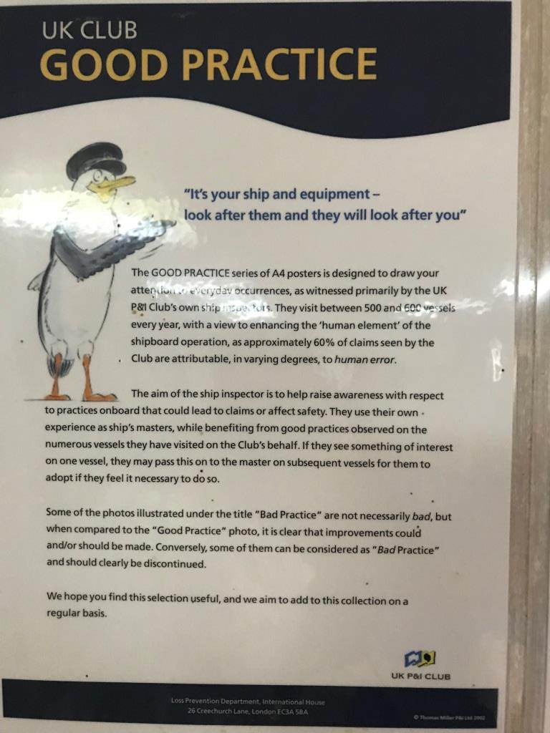
Problem Statement - Data
Poor Readability
Modest retaining of information
Information available was generic

Slide 4




Solution Finding
DATA
DESIGN
MATERIAL
INSTRUCTIONS

Slide 5
DESIGN
Designed by Professional
Emphasis on visuals
Maintained constant Graphics Vs Text ratio
Colours according to display location

Slide 6
MATERIAL
3M material to have professional outlook
10 years assurance on poster quality
Magnetic background for posters displayed in covered locations
Posters for weather deck are water resistant and easily cleanable

Slide 7
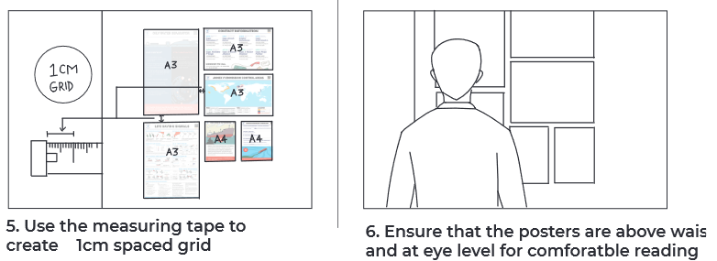
INSTRUCTIONS
INSTRUCTIONS
Restriction on display of ship generated notices or poster that are considered ‘GOOD TO HAVE’
Segregation of signage kit in various zone supported by precise display guidelines for each poster

Slide 8
SIGNAGE KIT JOURNEY
Signage Kit
Synergy SMS
Synergy Safety Needs
Vessel specific Requirement
Vessel Specific Kit
Each Vessel space survey

Slide 9
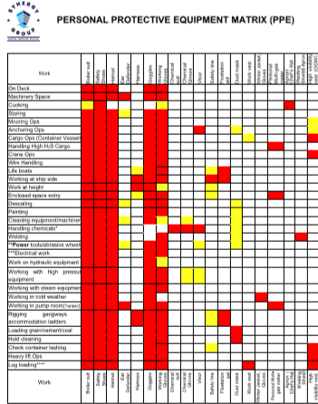
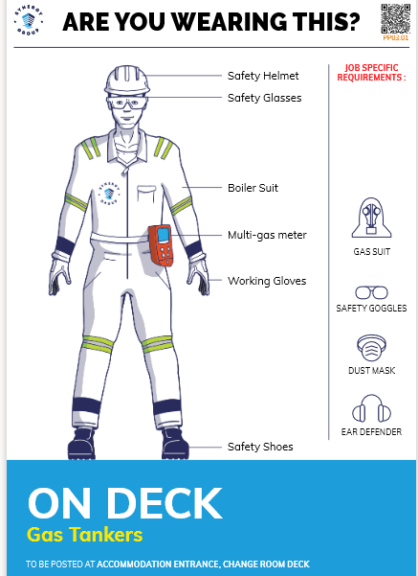

Slide 10
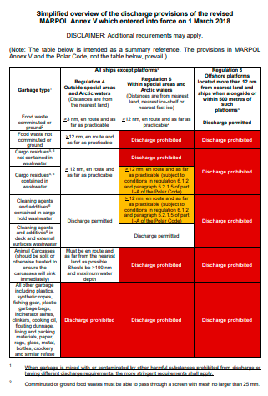
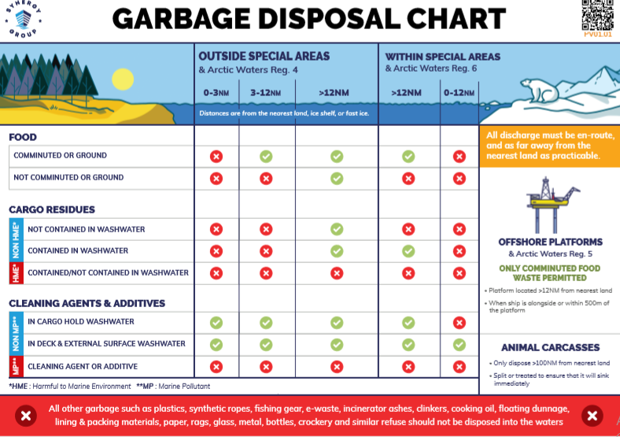

Slide 11
